Slide 1



AUTOMATIC DOOR LOCKING SYSTEM
BY: SHRUTI SHRI A

Slide 2

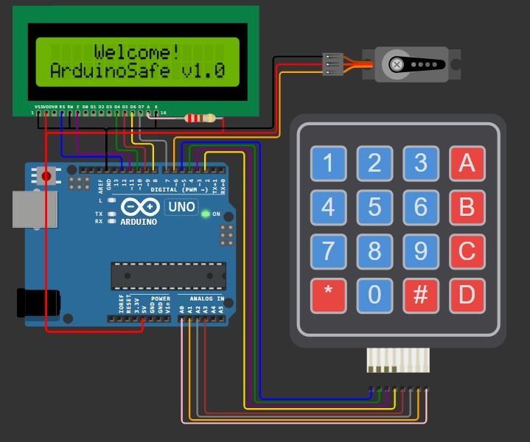
TINKERCAD DESIGN
https://wokwi.com/projects/411593347940831233

Slide 3

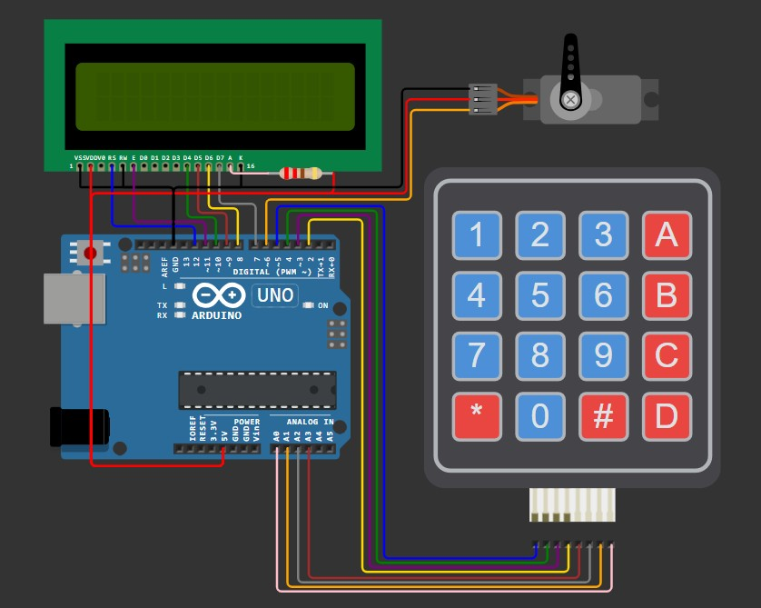
COMPONENTS REQUIRED
Liquid Crystal Display (LCD)
Servo Motor
Keypad
Arduino Uno

Slide 4

COMPONENTS EXPLANATION
Arduino Uno
Purpose: Acts as the brain of the system, coordinating the keypad input, LCD output, and servo motor control.
I/O Pins:
14 digital pins
6 analog input pins.
Power: Can be powered via USB or an external 9V/12V battery.
LCD (Liquid Crystal Display)
Type: 16x2 LCD (16 characters per line, 2 lines).
Usage:
Displays text to guide the user.
Interface:
Connected via 6 digital pins (D7 to D12 on Arduino).
Controlled using the
Liquid Crystal library.
4

Slide 5
Servo Motor
Keypad
Type: 4x4 Matrix Keypad.
Usage:
Takes user input, such as the 4-digit secret code.
Special keys (like ‘A’ and ‘#’) are used to set a new code or lock the safe.
Interface:
Row pins connected to
Arduino digital pins 2-5.
Column pins connected to
analog pins A0-A3.
Type: Standard servo motor (like SG90) with rotation typically limited to 180°.
Usage:
Controls the physical lock:
20° position: Locked.
90° position: Unlocked.
Interface:
Signal pin connected to digital
pin 6 on Arduino.
Power: Powered through the Arduino.
4

Slide 6

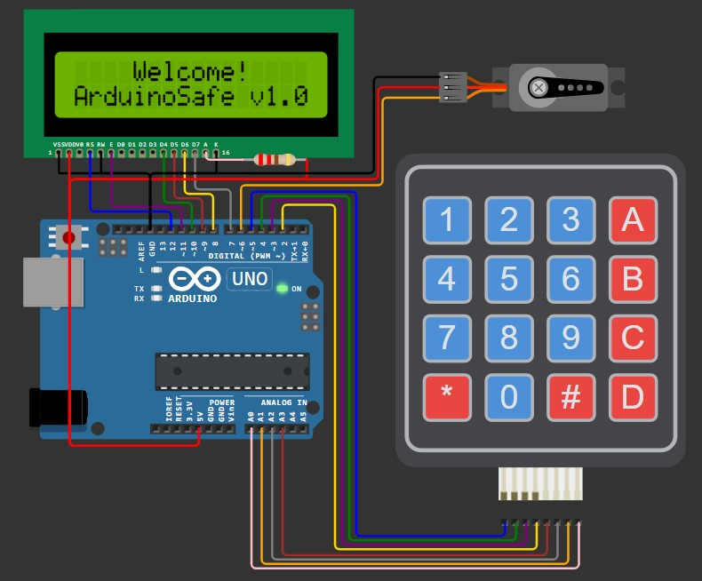
WORKING PRINCIPLE
System Initialization
Arduino initializes all components:
The LCD displays a welcome
message.
The servo motor is set to the correct position (locked or unlocked) based on the state stored in EEPROM.
If the safe is locked, the servo moves
to the locked position (20°).

Slide 7
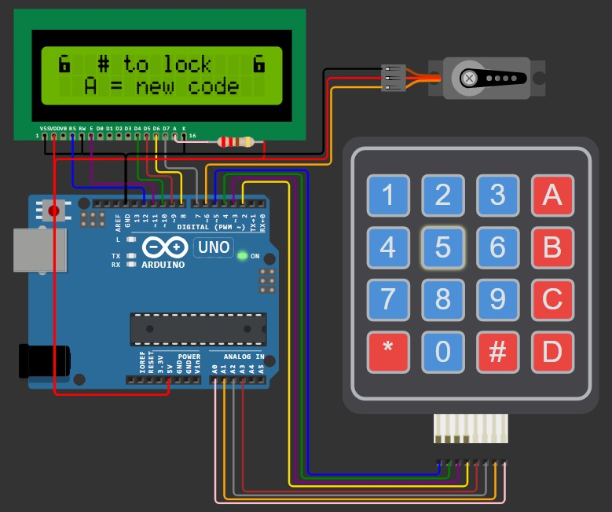
Input Mechanism (Keypad)
The 4x4 keypad is used to input:
Secret Code to unlock the safe.
Special commands like A (for setting a new code) and # (for locking).
Arduino reads the pressed key via row-column scanning of the keypad matrix.

Slide 8
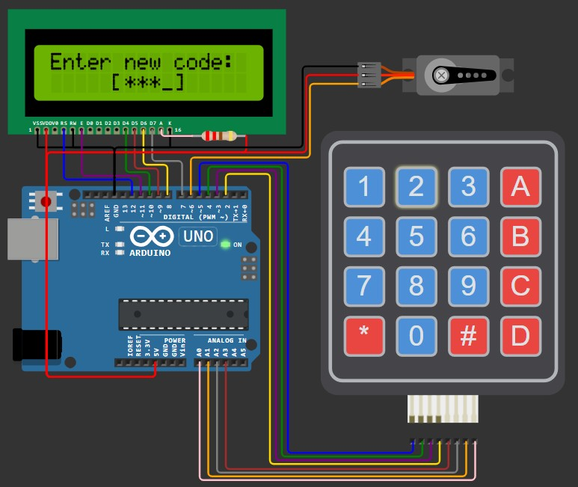
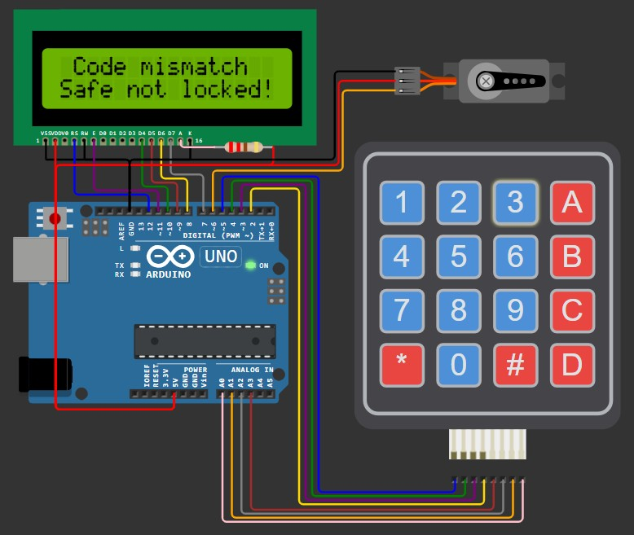
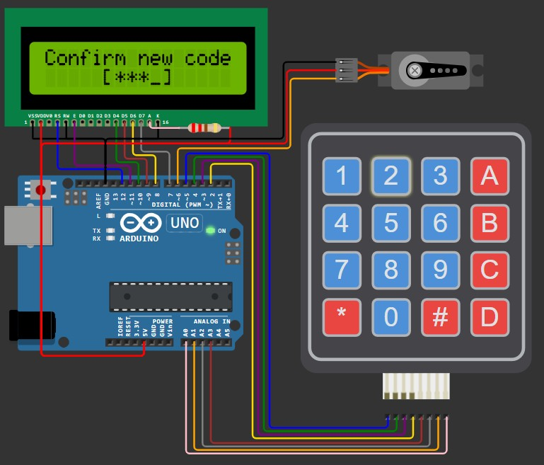
Setting a New Code
When the safe is unlocked, pressing A allows the user to set a new code:
The user enters the new 4-digit
code.
The code is confirmed by re- entering it.
If both inputs match, the new code is saved to EEPROM.
If there’s a mismatch, the process fails, and the LCD shows a message.

Slide 9
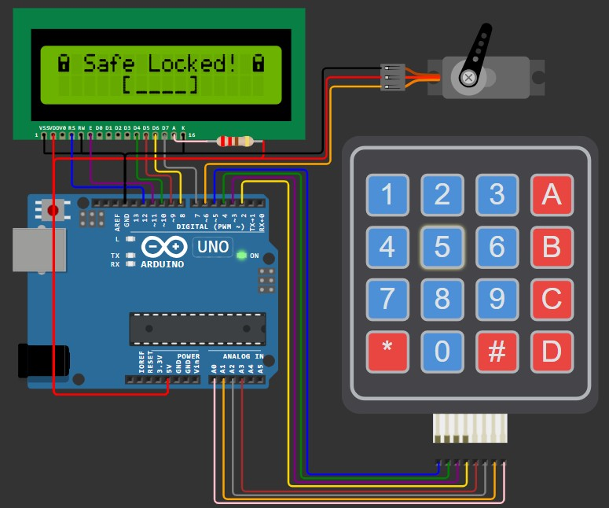
Locking Process
If the safe is unlocked:
The user can press # to lock the safe.
The servo motor rotates to 20° (locked position).
Arduino stores the state as locked in EEPROM for consistency on power resets.

Slide 10
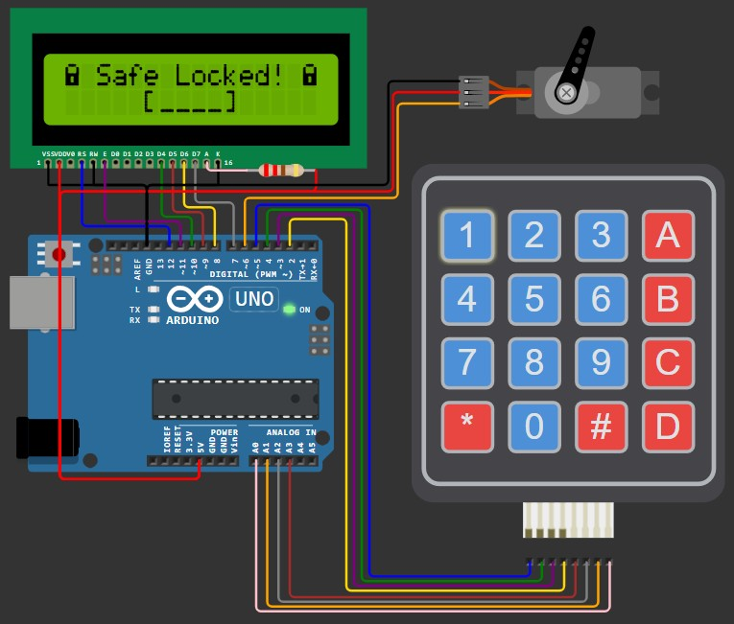
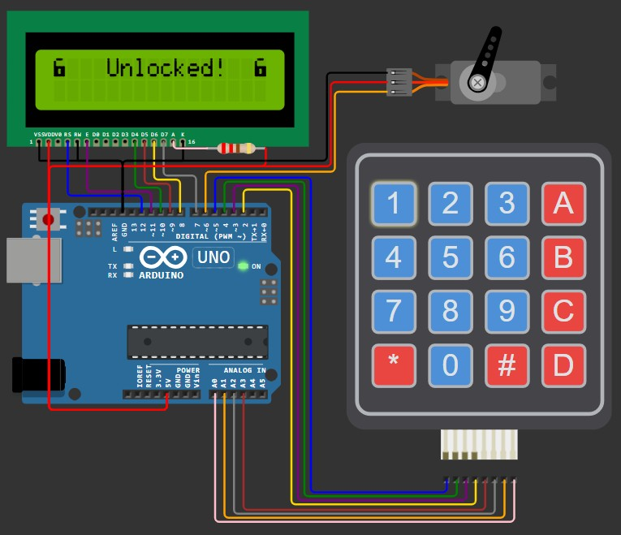
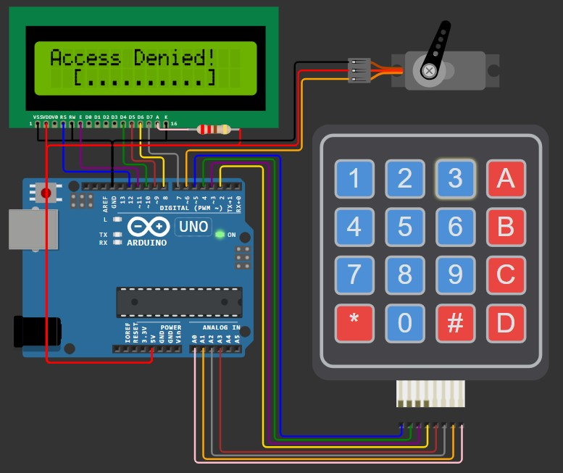
Unlocking Process
When the safe is locked, the user is
prompted to enter the 4-digit code.
Arduino compares the entered code with the stored code in EEPROM.
If the code matches:
The servo motor moves to the unlocked position (90°).
LCD displays "Unlocked!". 4.If the code is incorrect:
1. "Access Denied!" is shown on the
LCD, and the safe remains locked.

Slide 11

ALGORITHM
1. Initialization (setup)
Start the LCD display and initialize custom icons (if any).
Attach the servo motor to the specified pin.
Read the lock state from EEPROM.
If the state is locked, set the servo to locked position (20°).
If unlocked, set the servo to unlocked position (90°).
Display the startup message on the LCD.
2. Main Loop (loop function)
1. Check if the safe is locked or unlocked using the saved state.

Slide 12
3. Safe Locked Logic
If the safe is locked:
Display “Safe Locked” on the LCD.
Prompt the user to enter the secret code using the keypad.
Validate the entered code:
If the code matches the one stored in EEPROM:
Unlock the safe:
Move the servo to 90° (unlocked position).
Display "Unlocked!" on the LCD.
If the code is incorrect:
Display “Access Denied!” on the LCD.
Stay in the locked state.

Slide 13
4. Safe Unlocked Logic
If the safe is unlocked:
Display a message prompting the user to press # to lock or A to set a new code.
Wait for the user input:
If A is pressed:
Prompt the user to enter a new 4-digit code.
Ask the user to confirm the new code by re-entering it.
If the codes match:
Save the new code in EEPROM.
Display "Code Set!" on the LCD.
If the codes do not match:
Display "Code mismatch!" and return to the unlocked state.
If # is pressed:
Lock the safe:
Move the servo to 20° (locked position). Save the locked state in EEPROM.

Slide 14
5. Code Input Logic (inputSecretCode function)
Display a prompt to enter a 4-digit code.
Wait for the user to input 4 digits via the keypad.
o Display '*' for each digit as feedback.
Return the entered code.
6. Locking Process
1. Move the servo to the locked position (20°).
Save the locked state in EEPROM.
7. Unlocking Process
Move the servo to the unlocked position (90°).
Display "Unlocked!" on the LCD.

Slide 15
8. New Code Setting Logic (setNewCode function)
Display a message prompting the user to enter a new code.
Take the first input of 4 digits.
Ask the user to confirm the new code by entering it again.
If the two codes match:
Save the new code in EEPROM.
Return success.
If the codes do not match:
Display "Code mismatch!" and stay in the unlocked state.

Slide 16

CODE
Keypad keypad = Keypad(makeKeymap(keys), rowPins, colPins, KEYPAD_ROWS, KEYPAD_COLS);
/* LCD */
LiquidCrystal lcd(12, 11, 10, 9, 8, 7);
#include <LiquidCrystal.h> #include <Keypad.h> #include <Servo.h> #include "SafeState.h" #include "icons.h"
/* Define a structure to hold all components */ struct SafeComponents {
LiquidCrystal *lcd; Keypad *keypad; Servo *servo;
};
/* Locking mechanism definitions */ #define SERVO_PIN 6
#define SERVO_LOCK_POS 20
#define SERVO_UNLOCK_POS 90
/* Keypad setup */
const byte KEYPAD_ROWS = 4; const byte KEYPAD_COLS = 4;
byte rowPins[KEYPAD_ROWS] = {5, 4, 3, 2}; byte colPins[KEYPAD_COLS] = {A3, A2, A1, A0}; char keys[KEYPAD_ROWS][KEYPAD_COLS] = {
{'1', '2', '3', 'A'},
{'4', '5', '6', 'B'},
{'7', '8', '9', 'C'},
{'*', '0', '#', 'D'}
};
}
/* Servo */ Servo lockServo;
/* SafeState stores the secret code in EEPROM */ SafeState safeState;
/* Function prototypes */
void lock(struct SafeComponents *sc); void unlock(struct SafeComponents *sc);
String inputSecretCode(struct SafeComponents *sc); bool setNewCode(struct SafeComponents *sc);
void showStartupMessage(struct SafeComponents *sc); void showUnlockMessage(struct SafeComponents *sc); void showWaitScreen(struct SafeComponents *sc, int delayMillis);
void safeLockedLogic(struct SafeComponents *sc); void safeUnlockedLogic(struct SafeComponents *sc);
/* Create an instance of the SafeComponents structure */ struct SafeComponents sc = {&lcd, &keypad, &lockServo};
/* Lock the safe */
void lock(struct SafeComponents *sc) { sc->servo->write(SERVO_LOCK_POS); safeState.lock();
}
/* Unlock the safe */
void unlock(struct SafeComponents *sc) { sc->servo->write(SERVO_UNLOCK_POS);
}
16

Slide 17
/* Show startup message on the LCD */
void showStartupMessage(struct SafeComponents *sc) {
sc->lcd->setCursor(4, 0); sc->lcd->print("Welcome!"); delay(1000);
}
}
/* Set a new code for the safe */
bool setNewCode(struct SafeComponents *sc) { sc->lcd->clear();
sc->lcd->setCursor(0, 0);
sc->lcd->print("Enter new code:");
String newCode = inputSecretCode(sc);
sc->lcd->setCursor(0, 2);
String message = "ArduinoSafe v1.0";
for (byte i = 0; i < message.length(); i++) { sc->lcd->print(message[i]);
delay(100);
}
delay(500);
sc->lcd->clear();
sc->lcd->setCursor(0, 0);
sc->lcd->print("Confirm new code"); String confirmCode = inputSecretCode(sc);
}
if (newCode.equals(confirmCode)) {
safeState.setCode(newCode);
/* Input secret code using the keypad */
String inputSecretCode(struct SafeComponents | *sc) | { |  | return true;
sc->lcd->setCursor(5, 1); |  |  | } | else {
sc->lcd->print("[ ]"); |  |  |  | sc->lcd->clear();
sc->lcd->setCursor(6, 1); |  |  |  | sc->lcd->setCursor(1, 0);
String result = ""; |  |  |  | sc->lcd->print("Code mismatch");
while (result.length() < 4) { |  |  |  | sc->lcd->setCursor(0, 1);
char key = sc->keypad->getKey(); |  |  |  | sc->lcd->print("Safe not locked!");
if (key >= '0' && key <= '9') { |  |  |  | delay(2000);
sc->lcd->print('*'); |  |  |  | return false;
result += key; |  |  | }
} |  |  | }
}
return result;
/* Show unlock message */
void showUnlockMessage(struct SafeComponents *sc) { sc->lcd->clear();
sc->lcd->setCursor(0, 0);
sc->lcd->write(ICON_UNLOCKED_CHAR); sc->lcd->setCursor(4, 0);
sc->lcd->print("Unlocked!"); sc->lcd->setCursor(15, 0);
sc->lcd->write(ICON_UNLOCKED_CHAR); delay(1000);
}
/* Show wait screen */
void showWaitScreen(struct SafeComponents *sc, int delayMillis) { sc->lcd->setCursor(2, 1);
sc->lcd->print("[..........]"); sc->lcd->setCursor(3, 1);
for (byte i = 0; i < 10; i++) { delay(delayMillis);
sc->lcd->print("=");
17

Slide 18
/* Logic for when the safe is unlocked */
void safeUnlockedLogic(struct SafeComponents *sc) { sc->lcd->clear();
sc->lcd->setCursor(0, 0);
sc->lcd->write(ICON_UNLOCKED_CHAR); sc->lcd->setCursor(2, 0);
sc->lcd->print(" # to lock"); sc->lcd->setCursor(15, 0);
sc->lcd->write(ICON_UNLOCKED_CHAR);
/* Logic for when the safe is locked */
void safeLockedLogic(struct SafeComponents *sc) { sc->lcd->clear();
sc->lcd->setCursor(0, 0);
sc->lcd->write(ICON_LOCKED_CHAR); sc->lcd->print(" Safe Locked! "); sc->lcd->write(ICON_LOCKED_CHAR);
String userCode = inputSecretCode(sc);
bool unlockedSuccessfully = safeState.unlock(userCode); showWaitScreen(sc, 200);
if (unlockedSuccessfully) { showUnlockMessage(sc); unlock(sc);
} else {
sc->lcd->clear();
sc->lcd->setCursor(0, 0);
sc->lcd->print("Access Denied!"); showWaitScreen(sc, 1000);
}}
/* Setup function */ void setup() {
sc.lcd->begin(16, 2); init_icons(*sc.lcd); sc.servo->attach(SERVO_PIN);
/* Make sure the physical lock is sync with the EEPROM state */
Serial.begin(115200);
if (safeState.locked()) { lock(&sc);
} else {
unlock(&sc);
}
showStartupMessage(&sc);
}
/* Loop function */ void loop() {
if (safeState.locked()) { safeLockedLogic(&sc);
} else {
safeUnlockedLogic(&sc);
}}
bool newCodeNeeded = true;
if (safeState.hasCode()) { sc->lcd->setCursor(0, 1);
sc->lcd->print(" A = new code"); newCodeNeeded = false;
}
auto key = sc->keypad->getKey(); while (key != 'A' && key != '#') {
key = sc->keypad->getKey();
}
bool readyToLock = true;
if (key == 'A' || newCodeNeeded) {
readyToLock = setNewCode(sc);
}
if (readyToLock) { sc->lcd->clear();
sc->lcd->setCursor(5, 0);
sc->lcd->write(ICON_UNLOCKED_CHAR); sc->lcd->print(" ");
sc->lcd->write(ICON_RIGHT_ARROW); sc->lcd->print(" ");
sc->lcd->write(ICON_LOCKED_CHAR); safeState.lock();
lock(sc); showWaitScreen(sc, 100);
}}
18

Slide 19

ADVANTAGES
Increased Security: Prevents unauthorized access with code
protection.
User-Friendly Interface: Easy input and feedback for users.
Customizable: Allows for changing codes and settings as needed.
Automation: Reduces the need for manual locks, making it easier for elderly users.
19

